Slide 1
Healthy Brain Initiative for People with Intellectual and Developmental Disabilities
Matthew P. Janicki, Ph.D.
University of Illinois at Chicago and the National Task Group on Intellectual Disabilities and Dementia Practices
mjanicki@uic.edu
Webinar segment
May 4, 2021

Slide 2
Speaker Background
Research Associate Professor, Department of Disability and Human Development, University of Illinois at Chicago
Co-Chair, National Task Group on Intellectual Disabilities and Dementia Practices
Member, Federal Advisory Council on Alzheimer’s Research, Care, and Services
Principal investigator, Longitudinal study of specialized dementia-related care group homes designed for adults with intellectual disability
Formerly, Director for Aging and Special Populations for the New York State Office for People with Developmental Disabilities

Slide 3

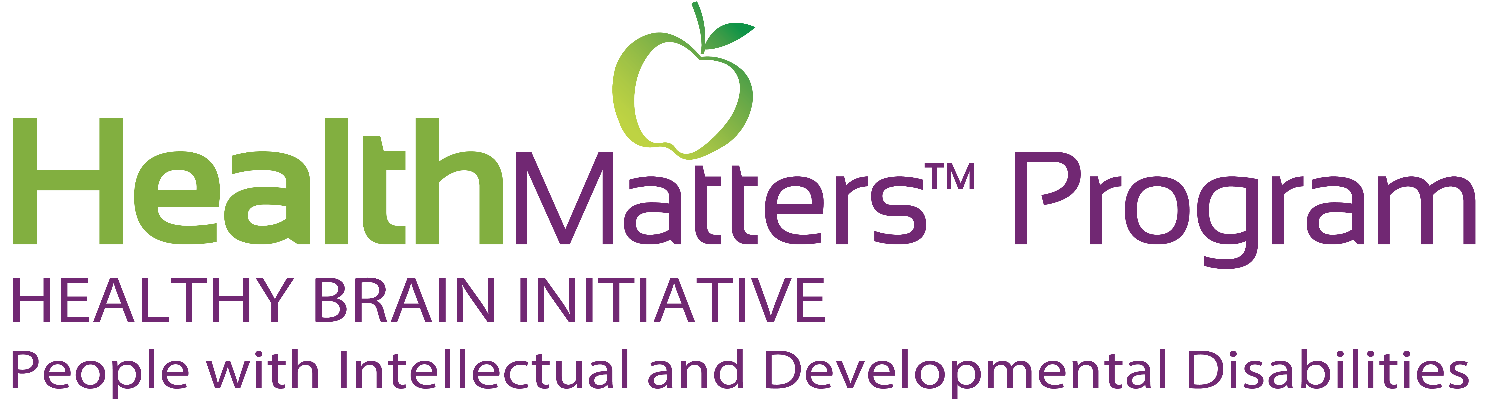



National Healthy Brain Initiative for People with Intellectual and Developmental Disabilities
The HBI-PwIDD Project, a partnership of the HealthMatters Program and ENGAGE-IL at the University of Illinois at Chicago, and the National Task Group on Intellectual Disabilities and Dementia Practices (NTG), is charged with creating a Road Map for Intellectual and Developmental Disabilities
It is one of three ‘Component B’ grant projects under the CDC’s National Healthy Brain Initiative -- which are charged to ‘support populations with a high burden of Alzheimer’s disease and other dementias’, by providing for education, and the development, promotion, and implementation of public health strategies to minimize the impact of dementia and which encourage brain health
The project collaborates with the CDC’s national BOLD centers
www.healthmattersprogram.org/hbi-pwidd/
A grant from the Centers for Disease Control and Prevention (CDC), National Center for Chronic Disease Prevention and Health Promotion, The Healthy Brain Initiative Award #1 NU58DP006782-01-00 supported the development of this presentation. Contents are solely the responsibility of the authors and do not represent the official views of CDC.
Notes:
Master HBI-PwIDD slide

Slide 4
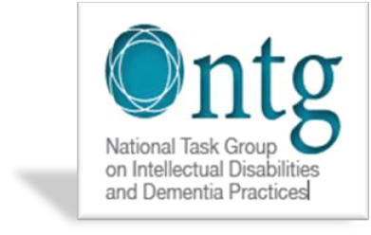
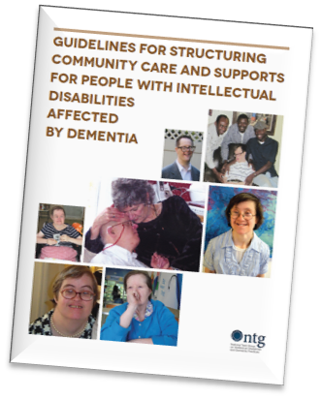
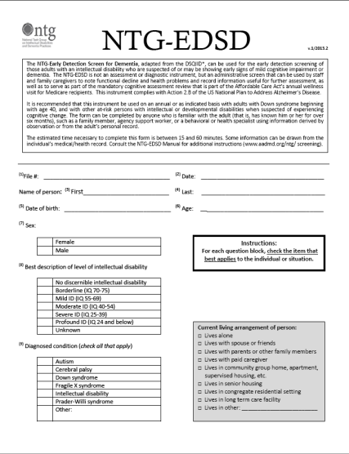
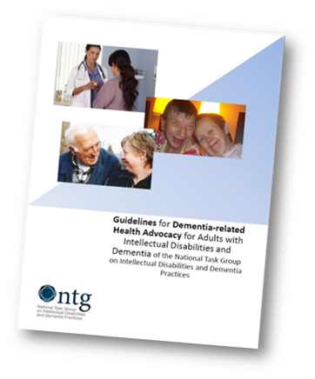
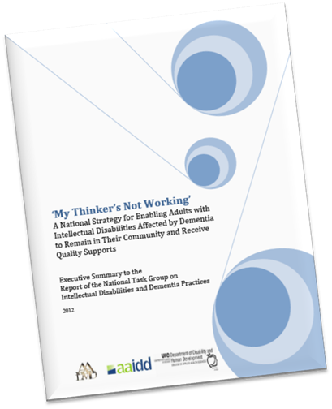

www.the-ntg.org
The National Task Group is a national non-profit organization with a charter to ‘advocate, provide technical and clinical assistance, disseminate information, aid with research, and create and provide educational and technical matter related to dementia among adults with intellectual disability’
NTG Key Activities…
‘Thinker’ report
  national plan for dementia and ID
Early detection-screening instrument
  NTG-EDSD
  SAFD
Practice guidelines
  Community supports
  Health advocacy
  Assessment
Training and education activities
  National education curriculum on dementia and ID
  Training workshops and webinars
Family supports
  Informational matter
  Support group
Participation
  Federal NAPA Council
  DS-Consortium (NICHD)
National Alzheimer’s Project Act
● NAPA - signed into law in 2011
● Required submission of an annual Alzheimer’s Plan to Congress – from 2012 to 2025
We aid in defining best practices that can be used by agencies when delivering supports and services to adults with intellectual disability affected the various dementias
We developed ‘first-instance’ early detection / screening instrument and working on a treatment tracking instrument
We produce educational materials of use to families, people with ID, and providers of services
We engage in discussion on public policy with respect to dementia as it affects adults with intellectual disability
We collaborate with federal and national organizations on matters related to ID and dementia

Slide 5
Activities of the NTG that relate to ‘brain health’
Collaboration with leading US Down syndrome associations and organizations in developing COVID-19 and ID informational materials
Studying impact of COVID-19 among providers
Creating resource guides for family caregivers … to improve care, health, and nutritional outcomes
Producing informational materials to enhance supports and services to affect lifestyle
Creating resources for families to better understand dementia and its impact
Offering trainings for agency personal on dementia
Being a partner in the Health Matters™ Program’s CDC grant on brain health

Slide 6
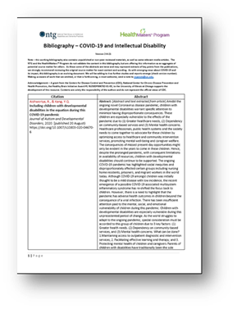
Socio/clinical findings about COVID-19 and Implications for brain health
Reduction or removal of support, increased social isolation (compounded by digital exclusion), and mental health issues had an impact on people with ID (SCPLD, 2020)
During lockdown periods and related social isolation, measures showed an increase of depressive symptoms and a worsening in functional status in adults with ID (Villani et al., 2020)
Persons with ID experienced massive disruption in health, home, and community services, increasing existing inequities in health care (Nygren & Lulinski, 2020)
Anecdotal data indicated high rates of infection among adults with ID and tests showed positivity for antibodies (even when symptoms were not noticed) – with possible residual effects
General population research already reporting some post-infection adverse neurological and psychiatric outcomes (Taquet et al., 2021)
Implications for Brain Health
Short term reactive effects due to lockdowns, dramatic changes in routines, stress from infection, and transfer of anxiety from others in home
Long term effects still to be determined, but there may be some residual neurological effects that affect behavior and brain health (‘post-COVID stress disorder’)
“Bibliography – COVID-19 and Intellectual Disability” - Sourced at: https://www.the-ntg.org/ and https://ahs.uic.edu/disability-human-development/coronavirus-disease-covid-19-resources/
Notes:
The Oxford study in The Lancet analyzed data from the electronic health records of 236,379 COVID-19 patients from the US-based TriNetX network, which includes more than 81 million people. This group was compared with 105,579 patients diagnosed with influenza and 236,038 patients diagnosed with any respiratory tract infection (including influenza). Overall, the estimated incidence of being diagnosed with a neurological or mental health disorder following COVID-19 infection was 34%. For 13% of these people, it was their first recorded neurological or psychiatric diagnosis. The most common diagnoses after COVID-19 were anxiety disorders (occurring in 17% of patients), mood disorders (14%), substance misuse disorders (7%), and insomnia (5%). The incidence of neurological outcomes was lower, including 0.6% for brain haemorrhage, 2.1% for ischaemic stroke, and 0.7% for dementia. After taking into account underlying health characteristics, such as age, sex, ethnicity and existing health conditions, there was overall a 44% greater risk of neurological and mental health diagnoses after COVID-19 than after flu, and a 16% greater risk after COVID-19 than with respiratory tract infections.
A new study from the United Kingdom found that people who were sick with COVID-19 had a significant chance of developing a psychiatric disorder after recovering.
According to the report Trusted Source published in The Lancet on November 9, 18 percent of COVID-19 patients developed a mental health issue — like depression, anxiety, or dementia — within 3 months of diagnosis. Their risk was doubled compared to people who didn’t have COVID-19. Doctors have suspected that COVID-19 was linked to higher rates of mental health problems.
A recent survey Trusted Source from Ecuador has also shown that people diagnosed with COVID-19 commonly experience anxiety, insomnia, depression, and post-traumatic stress disorder.
Though researchers are still working to understand exactly how the new coronavirus impacts not just the mind but brain function, this new research helps to further establish the link.
“COVID-19 can result in psychological issues due to both pandemic stress and the physical effects of the

Slide 7
Policy and Practice implications
Strengthening commitment among stakeholders to lifelong emphasis on health – with the commonality of mitigating dementia
Cross-cutting collaborations across population sectors around intellectual disability and lifelong health focus
Increasing understanding of lifelong lifestyle and lived experiences on enhancing later-life health and minimization of cognitive impairment
Incorporating within practices, policies and regulatory environments emphasis on healthy lifestyle and related practices to affect brain health
Enriching written and oral structures that can serve to inform and enhance positive lifelong practices by persons with intellectual disability
Incorporating ‘brain health’ into national and state dementia plans

