Slide 1




Healthy Brain and People with Intellectual
and Developmental Disabilities

Slide 2
What we will cover….
Why is dementia an issue among adults with intellectual and developmental disabilities
How do recent laws and court cases affect adults with intellectual and developmental disabilities
What are some of the factors related to assessment, care, and general functioning
What differs among systems that provide supports to people with intellectual and developmental disabilities
Are there variants to brain health and healthy brain practices?

Slide 3
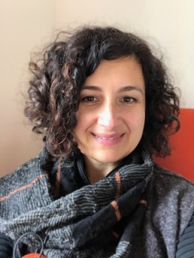

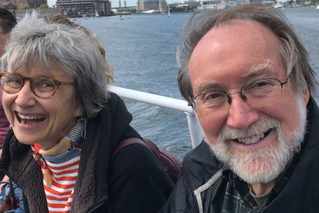

Our Team…
Jasmina Sisirak, PhD, MPH
Project Co-Director
Chicago, IL
Beth Marks, RN, PHD, FAAN
Project Co-Director
Chicago, IL
Valerie Gruss, PhD, RN
Director ENGAGE-IL
Chicago, IL
Matthew P. Janicki, PhD
NTG
Katherine Service, APN
NTG
www.the-ntg.org

Slide 4

National Healthy Brain Initiative Collaborative
Partnership
HealthMatters Program, University of Illinois at Chicago
(Beth Marks, PhD, RN, FAAN and Jasmina Sisirak, PhD, MPH)
National Task Group on Intellectual Disabilities and Dementia Practices (NTG)
(Matthew Janicki, PhD and Kathryn Service, RN)
ENGAGE-IL HRSA Geriatrics Workforce Enhancement Program (GWEP) (Valerie Gruss, PhD, APN, CNP-BC, FAAN)
A grant from the Centers for Disease Control and Prevention (CDC), National Center for Chronic Disease Prevention and Health Promotion, The Healthy Brain Initiative Award #1 NU58DP006782-01-00 supported the development of this presentation. Contents are solely the responsibility of the authors and do not represent the official views of CDC.
Notes:
‘support populations with a high burden of Alzheimer’s disease and other dementias’, by providing for education, and the development, promotion, and implementation of public health strategies to minimize the impact of dementia and which encourage brain health
The project collaborates with the CDC’s national BOLD centers

Slide 5
Dementia and Intellectual and Developmental Disabilities
1

Slide 6
Intellectual Disability and
Developmental Disability
The terms intellectual disability (ID) and developmental disability (DD), are often used interchangeably – however, there are notable differences between the two.
Developmental disabilities (DD)
- an umbrella term for many various conditions affecting children during the developmental period (usually before the late teens) and for adults continuing into old age
  Under federal law, a condition defined by a life-long impairment in physical, learning, language, or behavior (occurring before age 22)
  Some prevalent developmental disabilities in general population are:
    attention-deficit/hyperactivity disorder (ADHD), learning disability, developmental delay, autism spectrum disorder, various genetic disorders impairing typical development, speech impairment, intellectual disability, severe seizures, significant sensory losses or impairments, cerebral palsy
    Some conditions are sufficiently severe as to impair lifelong independent function; others are mitigated by medical and educational measures
  Low incidence of dementia – usually due to lower life expectancy
¹ Zablotsky, et al. Pediatrics, 2019, doi.org/10.1542/peds.2019-0811
Notes:
attention-deficit/hyperactivity disorder (ADHD) (9.5%), learning disability (7.9%), other developmental delay (4.1%), autism spectrum disorder (2.5%), stuttering or stammering, past 12 months (2.1%), intellectual disability (1.2%), seizures, past 12 months (0.8%), moderate/profound hearing loss (0.6%), cerebral palsy (0.3%), and blindness (0.2%).
The terms “developmental disability (DD)” and “intellectual disability (ID)” have two very different meanings. Although developmental disabilities may encompass intellectual disabilities, these two categories are not exactly the same thing.
Intellectual disabilities (ID) are disorders that originate before 18 years of age, possibly resulting from physical causes such as cerebral palsy, autism, or non-physical causes such as lack of stimulation. ID are characterized by a limited mental capacity and difficulty with adaptive behaviors such as handling routines or social situations. An intellectual disability describes someone who has a below-average intelligence quotient (IQ) and who lacks the skills needed for daily living.
Developmental disabilities (DD)are those that appear before 22 years of age. They are life-long disabilities that affect one or both physical and cognitive functioning. Some of these disabilities are physical, like blindness from birth for example. Others are both physical and intellectual disabilities, such as Down syndrome, cerebral palsy, or other genetic causes. Developmental disabilities are a group of conditions due to an impairment in physical, learning, language, or behavior areas . These conditions begin during development in youth.

Slide 7
Intellectual Disability (ID)
a specific condition under ‘developmental disabilities’ characterized by below-average intelligence and lacking skills needed for daily living and self-direction
Generally seen as originating before the late teens, but usually present in early childhood
Often associated with presence of cerebral palsy, autism, or seizure.
Causes can include genetics, birthing injuries, disease or illness affecting the brain, and environmental deprivation
High risk for dementia among adults with Down syndrome, otherwise prevalence generally like the general population

Slide 8
Intellectual disability (ID)
Characterized by
  Below normative intellectual functioning, due to cognitive impairment (organic or functional) present since birth or infancy
  Not a mental illness or psychiatric impairment
  Varies in degree and co-impairment
  Compensated by training, education, remediation, habilitation, supports for life activities
Down syndrome is a chromosomal abnormality present at birth (#21) associated with ID – In adults, age 40+, occurs in 10-12% of agency client pools
Developmental disabilities
Neuro-developmental conditions leading to impairments in physical, learning, language, or behavior areas
Originate before birth or during the developmental period, may impact day-to-day functioning, and usually last throughout a person’s lifetime
  Intellectual disability is a developmental disability
https://www.cdc.gov/ncbddd/developmentaldisabilities/facts.html
Notes:
Language defining DD taken and adapted from CDC website : https://www.cdc.gov/ncbddd/developmentaldisabilities/facts.html
“Developmental disabilities are a group of conditions due to an impairment in physical, learning, language, or behavior areas. These conditions begin during the developmental period, may affect day-to-day functioning, and usually last throughout a person’s lifetime.” source: https://www.cdc.gov/coronavirus/2019-ncov/need-extra-precautions/people-with-developmental-disabilities.html

Slide 9
Causes of Intellectual and Developmental Disabilities (IDD)
IDD can be the result of a variety of physiological or environmental conditions that occurs before the late teens – some occur before or at birth
Common Causes
  Genetic conditions
  Complications during pregnancy or birth
  Diseases or toxic exposure
Other Conditions
  Malnutrition
  Lack of access to appropriate healthcare or educational services
  Exposure to poisons like lead, mercury, or chemical toxins
Notes:
An intellectual disability can be caused by a problem that starts any time before a child turns 18 years old – even before birth
The most common causes of intellectual disability are:
Genetic conditions. Sometimes an intellectual disability is caused by abnormal genes inherited from parents, errors when genes combine, or other reasons. Examples of genetic conditions are Down syndrome, Fragile X syndrome, and phenylketonuria (PKU)
Complications during pregnancy. An intellectual disability can result when the baby does not develop inside the mother properly; for example, there may be a problem with the way the baby’s cells divide. A woman who drinks alcohol or gets an infection like rubella during pregnancy may also have a baby with an intellectual disability
Problems during birth. If there are complications during labor and birth, such as a baby not getting enough oxygen, he or she may have an intellectual disability
Diseases or toxic exposure. Diseases like whooping cough, the measles, or meningitis can cause intellectual disability
Another cause is exposure to extreme malnutrition, not getting appropriate medical care, or by being exposed to poisons like lead, mercury, or chemical toxins

Slide 10
Alzheimer’s Disease and Dementias
About 11,000 (6%) of the 180,000 older people 60+ with IDD will experience a form of dementia stemming from Alzheimer’s disease or other causes (% increases with age)
Dementia is NOT a natural course for most people with IDD. Exception is Down syndrome, which is a high risk factor for Alzheimer's disease
Evidence shows that people can reduce their risk of cognitive decline by making key lifestyle changes (physical activity, socially engaged, good heart health)
Notes:
Compared to their typical age peers, people with IDD struggle with social determinants of health (SDOH):
healthcare access and health promotive opportunities
social circumstances – income, education, employment, support
environmental issues –inclusive and accessible health promoting communities
People with IDD have more multiple chronic conditions (MCCs) at earlier ages compared to their peers.
complex health conditions, including mental health concerns, lower cancer and brain health screenings, preventive services, and limited access to healthcare
poorly managed MCCs with more high cholesterol, hypertension, cardiovascular disease, and obesity
poor health outcomes.

Slide 11

Disability is a natural and beautiful part of human diversity ~Sarah Triano, July 24, 2004
    Improved life expectancies
Medical care (Title V MCH)
Education (PL 94-143) and Employment
(7% Rule/Section 503 Amendment)
Social environment (Least restrictive
environment) (DD Act, Rehabilitation Act, ADA, ADAAA, Olmstead Decision)
  Disability does not diminish the right of individuals with IDD to:
    1) live independently, 2) exert control and choice over their own lives, and 3) fully participate in and contribute to their communities through the full integration and inclusion in the economic, political, social, cultural, and educational mainstream of American society -- with adequate supports.¹
¹DD Assistance and Bill of Rights Act of 2000 (DD Act) [Public Law 106–402]

Slide 12
IDD Component B
Our aims

Slide 13
National Healthy Brain Initiative Collaborative
Aims - Support “populations with a high burden of Alzheimer’s disease and other dementias”
  Education and training program and resources for healthcare and public health professionals and caregivers to provide person-centered care for adults with IDD and their supports
  Workforce development to expand and scale-up Healthy Brain Initiative Road Map Series (2018-2023) for adults with IDD and their supports
  Policies and partnerships to implement public health strategies to promote brain health
Notes:
‘support populations with a high burden of Alzheimer’s disease and other dementias’, by providing for education, and the development, promotion, and implementation of public health strategies to minimize the impact of dementia and which encourage brain health
The project collaborates with the CDC’s national BOLD centers

Slide 14
Healthy Brain Initiative
Promote Brain Health for persons with IDD and their supports¹
Social Determinants of Health
What Matters
Diet, Physical Activity, Alcohol, Tobacco, Drugs, Sexual Activity
Health Behaviors
Educate and Empower, Policies and Partnerships, and
Workforce Development²
Increased engagement in:
Physical Exercise
Food & Nutrition
Health Checks
Sleep & Relaxation
Mental Fitness
Social Interaction
realize abilities
manage life situations
optimize cognitive, emotional, psychological and behavioral functioning¹
Access to Quality Care
Clinical Care
Education, income, Employment, Family & Social Support, Community Safety
Social-Environmental Factors
Physical Environment
Air and Water Quality,
Housing and Transit
¹WHO
²Cleveland Clinic Healthy Brain
Notes:
Patient Profile Example
Health Domains
Where does meaningful and purposeful go… what matters the 4Ms. – mental fitness
Meaning and purpose of health and social interaction
Many interconnected social determinants of health (SDOH) impact brain development and brain health from pre-conception through the end of life³ . Determinants of health includes physical environment, individual health behavior, social-environmental factors, clinical care, and genetics and biology.
SDOHs influences brain development, adaptation, and ability to respond to stress and adversity, which creates opportunities to implement both health promotion and disease prevention across the life course. The HBI for persons with IDD and their supports is developing, adapting, and disseminating products and resources to increase engagement in 1) physical exercise; 2) food and nutrition; 3) medical health; 4) sleep and relaxation; 5) mental fitness; and, 6) social Interaction.
Cleveland Clinic Healthy Brains
https://healthybrains.org/pillars/
Physical Exercise
YOUR BODY: GET MOVING. People who exercise regularly have a lower risk of developing Alzheimer’s disease. Exercise improves blood flow and memory; it stimulates chemical changes in the brain that enhance learning, mood and thinking. Be fit. Be smart.
Food & Nutrition
EAT SMART, THINK BETTER. You are what you eat. As you grow older, your brain is exposed to more harmful stress due to lifestyle and environmental factors, resulting in a process called oxidation, which damages brain cells. Rust on the handlebars of a bike or a partially eaten apple gives you an idea of the kind of damage oxidation can cause to your brain. Food rich in antioxidants can help fend off the harmful effects of oxidation in your brain.
Medical Health - Health Check Management – clinician trained to focus on medical health
E.g., better terms like Engagement, connection, autonomy, control, choices, literacy
CONTROL MEDICAL RISKS. Hypertension, diabetes, obesity, depression, head trauma, higher cholesterol, and smoking all increase the risk of dementia. You can control and reduce these risks. Get your annual check-up, follow your doctor’s recommendations and take medications as prescribed. Get engaged in a brain healthy lifestyle for your body and your mind.
Sleep & Relaxation
REST WELL. Sleep energizes you, improves your mood and your immune system, and may reduce buildup in the brain of an abnormal protein called beta-amyloid plaque, which is associated with Alzheimer’s disease. Practicing meditation and managing stress may help fend off age-related decline in brain health. Stay positive. Be happy.
Mental Fitness
YOUR MIND: USE IT OR LOSE IT. Mental exercise is just as critical as physical exercise in keeping your brain fit and healthy. Mental exercises may improve your brain’s functioning and promote new brain cell growth, decreasing your likelihood of developing dementia. Like your muscles, you have to use your brain or you lose it.
Social Interaction
STAY CONNECTED. Leading an active social life can protect you against memory loss. Spending time with others, engaging in stimulating conversation, and staying in touch and connected with family and friends are good for your brain health. Studies have shown that those with the most social interaction in their community experience the slowest rate of memory decline.

Slide 15

UIC HBI Collaborators
Copyright 2021 HealthMatters Program
Alzheimer’s Association
American Academy of Developmental Medicine and Dentistry (AADMD)
American Association on Health & Disability
American Association on Intellectual and Developmental Disabilities (AAIDD)
Association of University Centers on
Disabilities (AUCD)
CARF
Community Living Policy Center, Lurie Institute for Disability Policy at Brandeis University
Council on Quality and Leadership (CQL)
Down Syndrome Medical Interest Group (DSMIG)
ENGAGE-IL GWEP
Exceptional Parent (EP)
Global Down Syndrome Foundation
Golisano Institute for Developmental Disability Nursing
Illinois Council on Developmental Disabilities (ICDD)
Midwest Roybal Center for Health Promotion and Translation
National Alliance for Direct Support Professionals (NADSP)
National Center on Health, Physical Activity and Disability (NCHPAD)
National Association of Councils on Developmental Disabilities (NACDD)
National Down Syndrome Congress (NDSC)
National Down Syndrome Society (NDSS)
National Task Group on Intellectual Disabilities and Dementia Practices
Project SEARCH
Special Olympics (SO)
The ARC

Slide 16
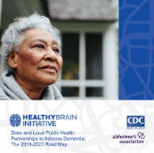
HBI Community of Practice for People with IDD and their Supports
Copyright 2021 HealthMatters Program
Create “one-stop space”
  Awareness of ADRDs among PwIDD as a public health issue
  Public health strategies to improve the quality of life of PwIDD
  Caregiver health and wellness to optimize
  care for PwIDD with inclusive Healthy
  Brain resources and trainings
Improve health equity for people
experiencing ADRDs
Enhance opportunities for PwIDD and
supports to actively engage in lifestyle
goals, preferences, and options

Slide 17
Some notions about dementia and intellectual disability
National Task Group on Intellectual Disabilities and Dementia Practices (NTG)
Matthew Janicki

Slide 18
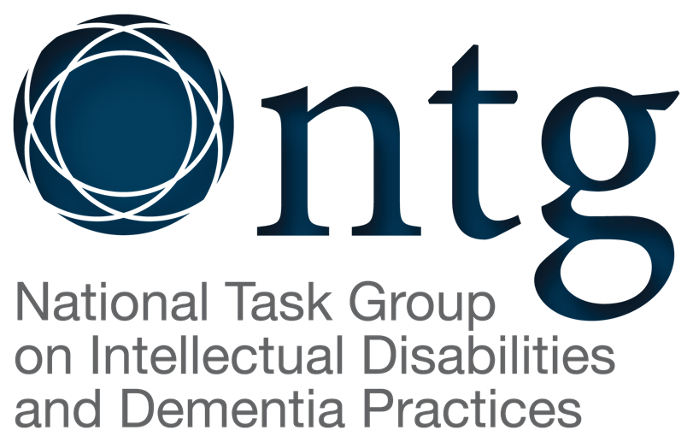
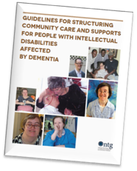
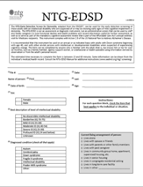
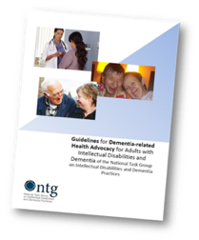
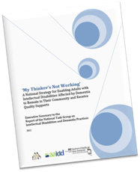
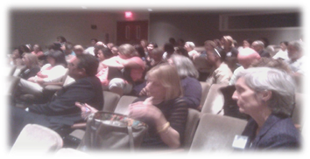
National Alzheimer’s Project Act
● NAPA - signed into law in 2011
● Required submission of an annual Alzheimer’s Plan to Congress – from 2012 to 2025
www.the-ntg.org
The National Task Group is a national non-profit organization with a charter to ‘advocate, provide technical and clinical assistance, disseminate information, aid with research, and create and provide educational and technical matter related to dementia among adults with intellectual disability’
We aid in defining best practices that can be used by agencies when delivering supports and services to adults with intellectual disability affected the various dementias
We developed ‘first-instance’ early detection / screening instrument and working on a treatment tracking instrument
We produce educational materials of use to families, people with ID, and providers of services
We engage in discussions on public policy with respect to dementia as it affects adults with intellectual disability
We collaborate with federal and national organizations on matters related to ID and dementia

Slide 19
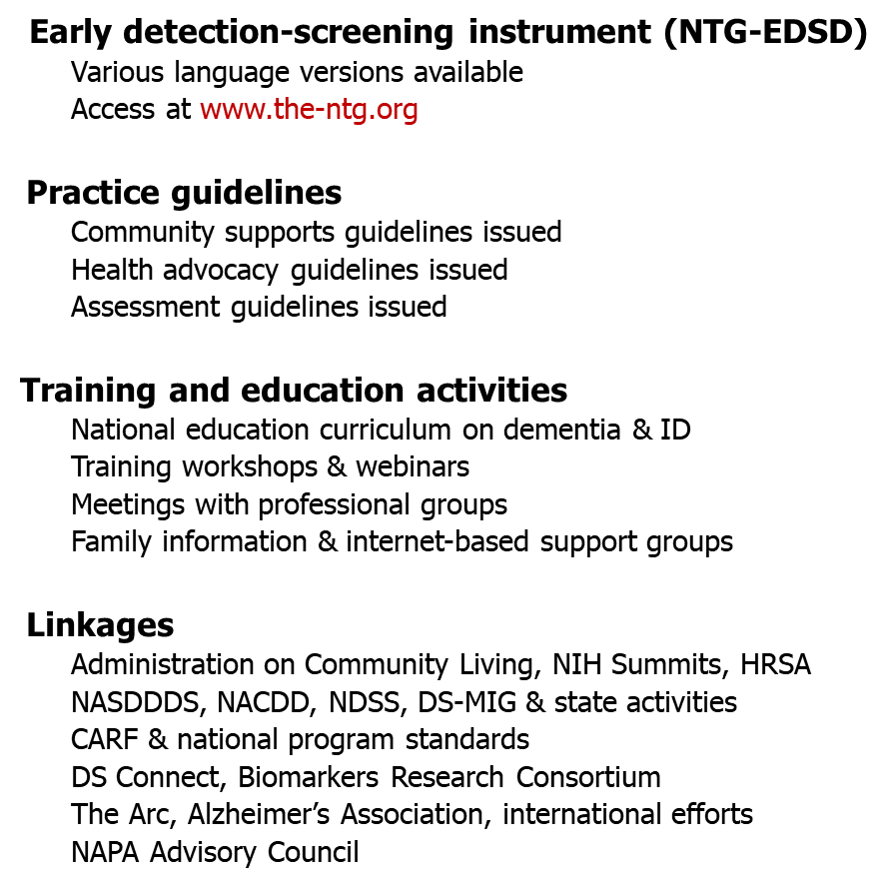
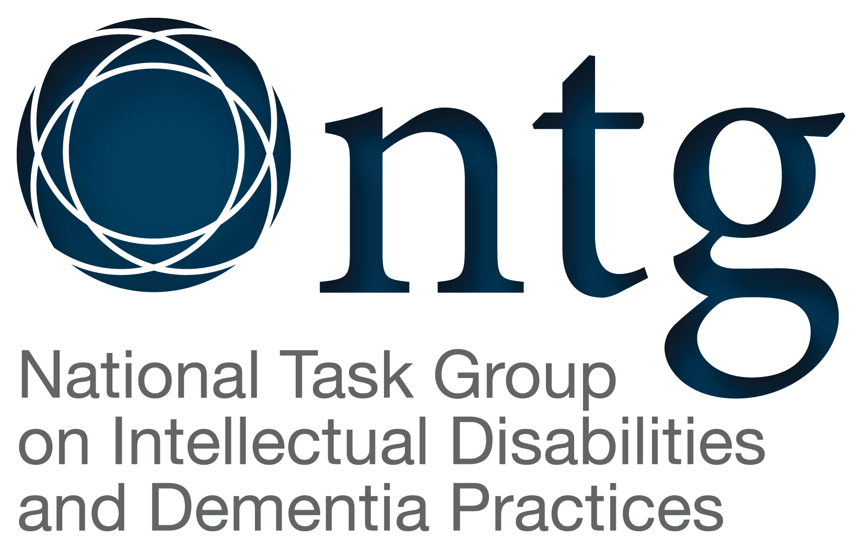
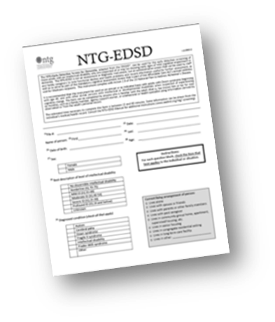
NTG resources and linkages
www.the-ntg.org

Slide 20
Activities of the NTG that relate to ‘brain health’
Collaboration with leading US Down syndrome associations and organizations in developing COVID-19 and ID informational materials
Studying impact of COVID-19 among providers
Creating resource guides for family caregivers … to improve care, health, and nutritional outcomes
Producing informational materials to enhance supports and services to affect lifestyle
Creating resources for families to better understand dementia and its impact
Offering trainings for agency personal on dementia
Being a partner in the Health Matters™ Program’s CDC grant on brain health

Slide 21
What have we found that differentiates families and people with IDD
Families are ‘perpetual caregivers’ – proving home-based care from birth on
Families are ‘adaptors’ – they have learned how to care for their child, but are often challenged in later life with the onset of dementia
Onset of dementia is often earlier (DS – early 50s; ID – late 60s)
Assessment is a challenge due to ID and communication and variations in innate knowledge, and lack of experience by MDs
Care practices often similar, but ID system effectively uses a small group care model and supports for families
State IDD agencies support older age care and dementia related services

Slide 22

ID & Dementia Support-staging Model (Helping carers)
Influence of carer staging – 4 phases
Diagnostic phase
Explorative phase
Adaptive phase
Closure phase
Validation of cause of
change in function
Accepting diagnosis,
considering options
Managing the issue or
symptom
Resolution, relief, redefining
next steps
Notes:
The Diagnostic phase calls for the need for policies and services that support dementia diagnostic centers that are also skilled in diagnosing adults with intellectual disability
The Explorative phase calls for the need for policies for education and information for families on dementia and intellectual disability
The Adaptive phase calls for the need for policies on supporting families and adults with ID affected by dementia, often with specialized services
The Closure phase calls for the need for policies dealing with terminal care, grieving, and adapting to post-caregiving

Slide 23
Impact and changes… ID and dementia
Rate of occurrence^{1,3,5,8,14} | Age-cohort percent for adults with intellectual disability (ID) is same as in general population (~5-6% over 60) Much higher prevalence (60% >age 60) and neuropathology indicative of AD in most adults with Down syndrome (DS)
Dementia type^{2,9} | Generally, dementia of the Alzheimer’s type is prevalent in DS Similar range of dementias found in other ID as in other people
Risk¹⁵ | DS and head trauma are significant risk factors in ID
Onset^{1,2,3,10} | Average onset age in early 50s for DS – late 60s for others Most DAT diagnosed within 3 years of “onset” in adults with DS
Behavioral changes^{2,3,6,11,12,13} | In DS - early change in personality more evident In other ID - initial memory loss more evident Notable changes in behavior - apathy, sleep disturbance, agitation, incontinence, uncooperativeness, irritability, aggressiveness
Neurological signs^{1,2,4,7,16,17,18,19} | Late onset seizures in 24%-53% of adults w/DS Late onset seizures in DS indicator of life expectancy of less than 2 years Seizures more common at end-stage (84%) versus at mid-stage (39%) Alzheimer’s disease
Duration^{2, 17} | Aggressive AD can lead to death <2 years of onset in DS 2-7+ years mean duration in DS; probable death within 3-5 years of onset Same duration expected among other ID as in other people with dementia
Sources: ¹Janicki, M.P. & Dalton, A.J. (2000). Prevalence of dementia and impact on intellectual disability services. Mental Retardation,38, 277-289. ²Janicki, M.P., & Dalton, A.J. (1999). Dementia, Aging, and Intellectual Disabilities: A Handbook. Philadelphia: Brunner-Mazel; ³Bush, A., & Beail, N. (2004). Risk factors for dementia and Down syndrome. AJMR, 109, 83-97. ⁴ Menendez M. (2005). Down syndrome, Alzheimer's disease and seizures. Brain Development, 27(4), 246-252. ⁵Zigman, W.B., Schupf, N., Devenny, D., et al. (2004). Incidence and prevalence of dementia in elderly adults with MR without DS, AJMR, 109, 126-141. ⁶Ball, S.L., Holland, A.J., Hon, J., Huppert, F.A., Treppner, P., & Watson, P.C. Personality and behavior changes mark the early stages of Alzheimer's disease in adults with Down's syndrome: findings from a prospective population-based study. International Journal of Geriatric Psychiatry, 2006, [Jun 26]. ⁷Crespel, A., Gonzalez, V., Coubes, P., & Gelisse, P. (2007). Senile myoclonic epilepsy of Genton: Two cases in Down syndrome with dementia and late onset epilepsy. Epilepsy Research, 77,165-168. ⁸Evenhuis, H. (1997). The natural history of dementia in ageing people with intellectual disabilities. JIDR. 41(1), 92-96. ⁹Strydom, A., Livingston, G., King, M., & Hassiotis, A. (2007).Prevalence of dementia in ID using different diagnostic criteria. Br. J. Psychiatry, 191, 150-157. ¹⁰ Margallo-Lana et al., (2007). Fifteen year follow-up of 92 hospitalized adults with DS. JIDR, 51, 463-477. ¹¹Gianpietro, N. (2013). Research in dementia in Down syndrome. Presentation at the SR Congresso Internazionale sulla Sindrome di Down, Roma, Italy, November 9, 2013. ¹²Deb S. , Hare M., & Prior L. (2007). Symptoms of dementia among adults with Down's syndrome: a qualitative study. Journal of intellectual disability Research , 51(9), 726-739. ¹³Cooper, S-A. (1997). A population-based health survey of maladaptive behaviours associated with dementia in elderly people with learning disabilities. Journal of Intellectual Disability Research, 41(6), 481-487. ¹⁴ Torr, J.,& Davis, R. (2007). Ageing and mental health problems in people with intellectual disability. Current Opinion in Psychiatry, 20(5), 467-471. ¹⁵Moran J.A., Rafii, M.S., Keller, S.M., Singh, B.K., & Janicki, M.P., (2013). The National Task Group on Intellectual Disabilities and Dementia Practices consensus recommendations for the evaluation and management of dementia in adults with intellectual disabilities. Mayo Clinic Proceedings, 88(8), 831-840. ¹⁶ Esbenson, A.J., (2010). Health conditions associated with aging and end of life of adults with Down syndrome. Int Rev Res Ment Retard. 2010 ; 39(C): 107–126. ¹⁷ Prasher, V.P. & Corbett, J.A> (1993). Onset ofseizures as a poor indicator of longevity in people with down syndrome and dementia. International Journal of Geriatric Psychiatry, 8(11), 923–927. ¹⁸ Robertson, Hatton, Emerson, & Baines. (2015). Prevalence of epilepsy among people with intellectual disabilities: A systematic review. Seizure, 29, 46–62. ¹⁹ McCarron M, Gill M, McCallion P, Begley C. (2005). Health co-morbidities in ageing persons with Down syndrome and Alzheimer’s dementia. J Intellect Disabil Res., 49, 560–566. 3/16
Notes:
1/20 version

Slide 24
Prevalent dementia care options in ID and their intent
Institutional care
[long term care facilities, nursing homes, old age homes, dementia special care units]
Neighborhood group homes
[generic group homes, specialized group homes]
Group homes for persons with ID who age in the homes
Group homes for specialized dementia care
Family care
[living with family, other relatives, or other family members of carers]
Sheltered dementia care
[assisted living, dementia care homes]
Carer
supports
Small personalized care settings

Slide 25
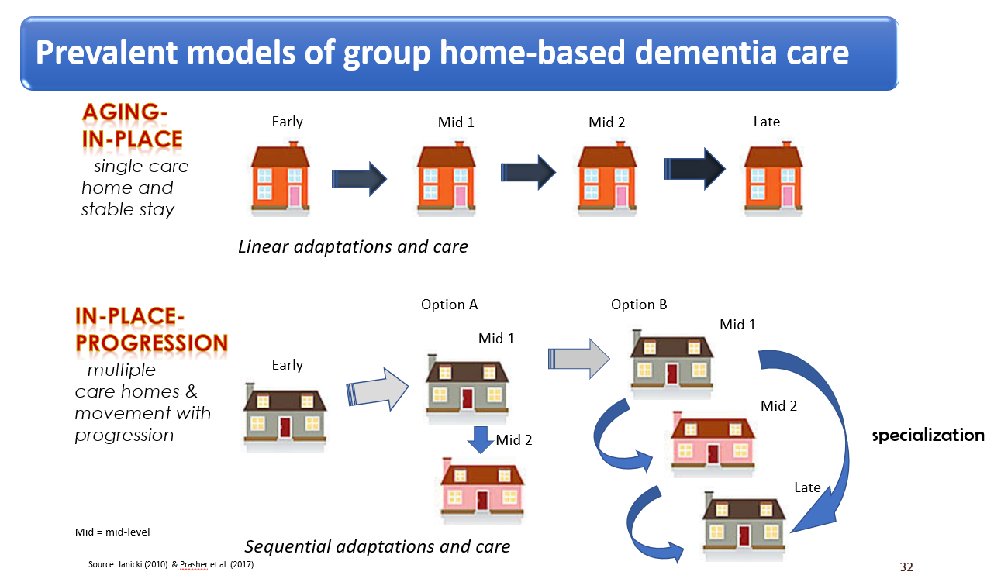

Slide 26
Policy and Practice implications
Strengthening commitment among stakeholders to lifelong emphasis on health – with the commonality of mitigating dementia
Cross-cutting collaborations across population sectors around intellectual disability and lifelong health focus
Increasing understanding of lifelong lifestyle and lived experiences on enhancing later-life health and minimization of cognitive impairment
Incorporating within practices, policies and regulatory environments emphasis on healthy lifestyle and related practices to affect brain health
Enriching written and oral structures that can serve to inform and enhance positive lifelong practices by persons with intellectual disability
Incorporating ‘brain health’ into national and state dementia plans

Slide 27
Personal aspects of care
National Task Group on Intellectual Disabilities and Dementia Practices (NTG)
Kathryn Service

Slide 28
What’s the Connection?
BRAIN HEALTH
Intellectual Disabilities
Dementia

Slide 29
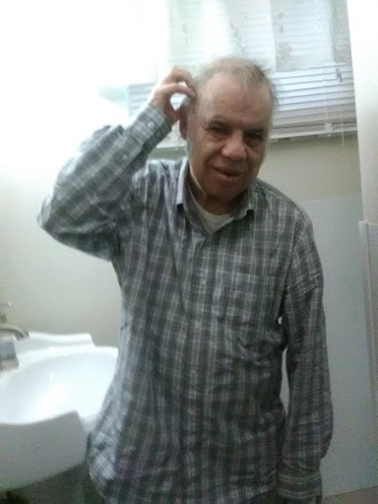
In practice:
Lifespan approach
Shift in “Philosophy” ≠ Shift in Respect & Dignity
LIVING with dementia
Person centered yet relationship centered = Partnership
Value of Knowledge

Slide 30
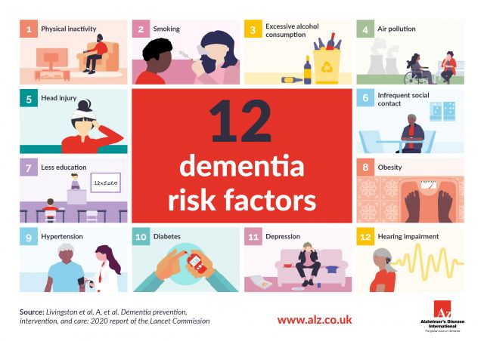
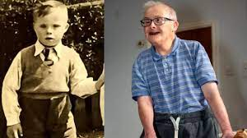
The Lifespan
BRAIN HEALTH matters throughout!
It’s never too late!

Slide 31
Changing Focus in ID Support
BEFORE the Diagnosis
Learning New Skills
Independence & Autonomy Valued and Encouraged
Behavior Modification
MORE Choices, Stimulation, Community Outings
Focus on Doing
AFTER the Diagnosis
Maintain Function & Prevent Excess Disability
“Hands-on” Personal Care
Predictable, Consistent Routine
Failure-free Choices
Social Interactions!
Focus on Feeling & Being
        Service, 2002, 2017

Slide 32
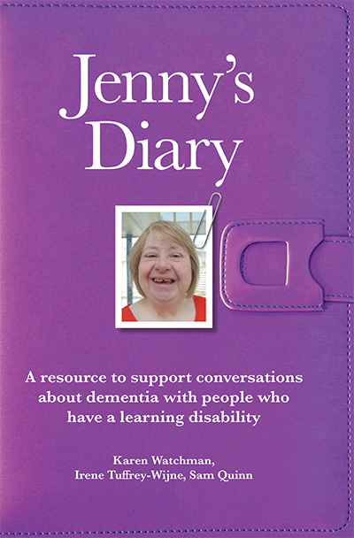
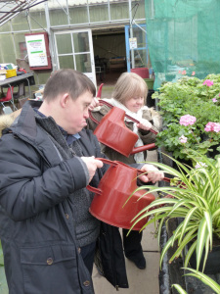
Living with Dementia
The Value of the Life Story
Remaining Active and Engaged
Physical Exercise
Food & Nutrition
Medical Health
Sleep & Relaxation
Mental Fitness
Social Interaction
Notes:
From Jenny’s Diary

Slide 33
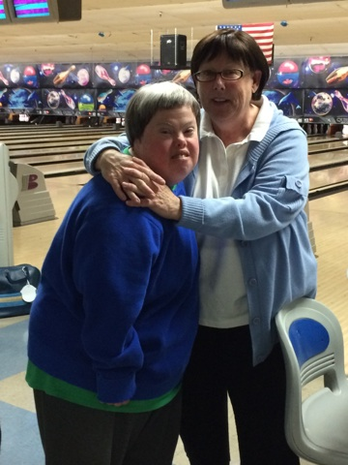
Brain Health is both person-centered yet relationship centered
For the person with Intellectual Disabilities
For the Care Partner
When?

Slide 34
Educate and Empower, Policies and Partnerships, and Workforce
Development
THE NTG WEBSITE:
MY THINKER'S NOT WORKING
FREQUENTLY ASKED QUESTIONS
GUIDELINES FOR EVALUATION AND MANAGEMENT OF DEMENTIA IN ADULTS WITH ID
GUIDELINES FOR STRUCTURING COMMUNITY CARE AND SUPPORTS FOR PEOPLE WITH ID AFFECTED BY DEMENTIA
GUIDELINES FOR DEMENTIA-RELATED HEALTH ADVOCACY FOR ADULTS WITH ID AND DEMENTIA
www.the-ntg.org

Slide 35
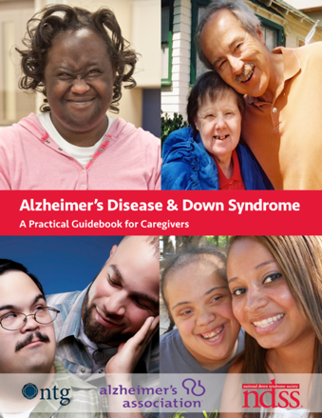

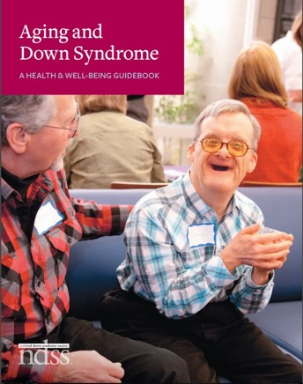


Person/Family Centered Resources
www.learningdisabilityanddementia.org/jennys-diary.html
http://www.sevenhills.org/uploads/SHRI-IDD-ADRD-Resource-Guide.pdf
http://www.ndss.org/wp-content/uploads/2017/11/Aging-and-Down-Syndrome.pdf
http://www.ndss.org/wp-content/uploads/2017/11/NDSS_Guidebook_FINAL.pdf
https://booksbeyondwords.co.uk/bookshop/paperbacks/ann-has-dementia

Slide 36

Questions?
  Do you have any issues and needs for brain health?
  What types of brain health resources/information would be useful?
  For more information contact:
  Jasmina Sisirak, PhD, MPH
  jsisirak@uic.edu

Slide 37
Join us for Webinar 2: May 25th, 2021 (1pm-2pm CT)
Brain Health Across the Lifespan for People with Intellectual and Developmental Disabilities
Lucille Esralew, PhD, NADD-CC
Office of Statewide Clinical Services, Clinical Services Branch for
the California Department of Developmental Services

