Slide 1
Components of Dementia-Capable Group Home Care
Matthew P. Janicki, Ph.D.
University of Illinois at Chicago
mjanicki@uic.edu
Presentation at the meeting of the Lifelong Disabilities SIG, Gerontological Society of America Conference, Orlando, Florida on November 20, 2015

Slide 2
U.S. National Plan to Address Alzheimer’s
Disease
Calls for -- among other things….
☑ Issuance of practice guidelines for care and supports and expanded public education
☑ Promotion of assessment tool for detection of cognitive impairment as part of the annual wellness visit
Enhanced supports for caregivers
Community care supports and services
☑ Expanded research
Special task groups on I/DD
Released on May 15, 2012
Updated annually until 2025!

Slide 3
Opportunistic study
ID agency in mid-West decided to open three purpose-built group homes to provide in-community care for their clients with dementia.
We came across the homes during a consult at the agency – providing training on ID and dementia.
Homes were already built, but in final stages of finishing work.
Agency agreed to participate in study focusing on the three homes
Once methodology and instruments were identified, and IRB clearances were obtained, the agency began data collection.

Slide 4
Study Premise
Given the cluster model employed by an agency of three ‘in-place progression’ homes …
Our hypothesis is that eventually, as changes affect the residents, the agency will begin to specialize the homes based on function and stage
If this happens, it will show that as homes are established for dementia care, their character will eventually change due to the nature of dementia and that home specialization is an organic outcome of multiple group home availability

Slide 5
Our hypothesis is that eventually, as changes affect the residents, the agency will begin to specialize the homes based on function and stage
If this happens, it will show that as homes are established for dementia care, their character will eventually change due to the nature of dementia and that home specialization is an organic outcome of multiple group home availability
Background
More local agencies are taking responsibility for the later-life care of aging adults with intellectual disabilities and are developing small dementia-care group homes.
The homes are designed to be ‘dementia-capable’ and provide extended older age care.
As dementia affects adults differentially, both with respect to symptoms and decline, it might be that individual dementia care homes will eventually be defined by their residents in terms of residual functional skills and degree of personal care needs.
Aim of Study
Given that stage-specific changes eventually occur, it was of scientific interest to conduct a longitudinal study of three such dementia-care community-based group homes to observe progression of decline, resident needs, and adaptations to care practices.

Slide 7
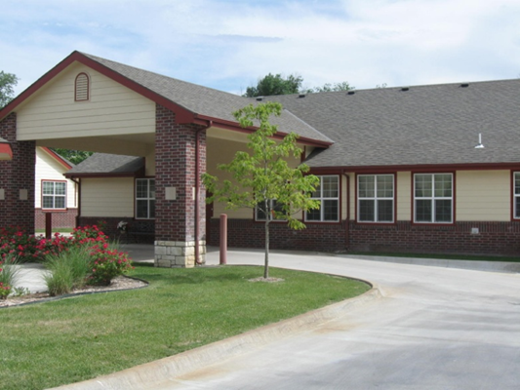
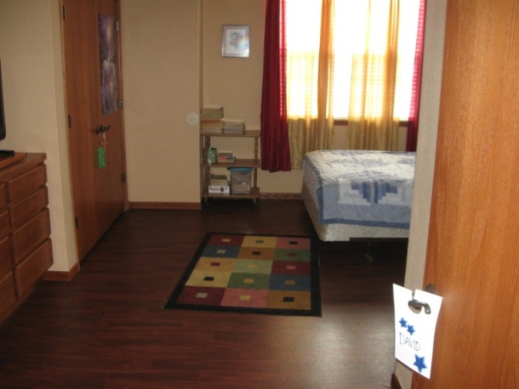
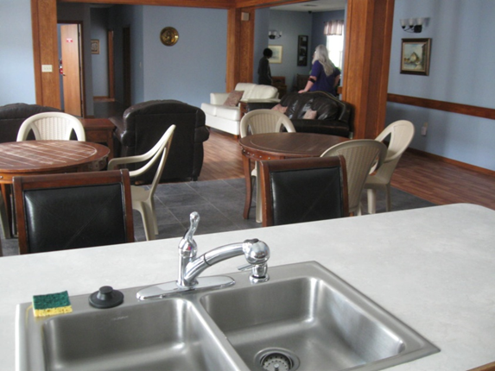
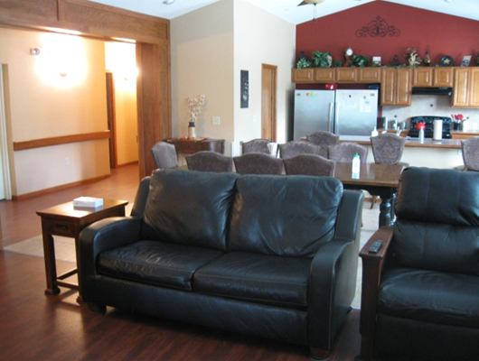
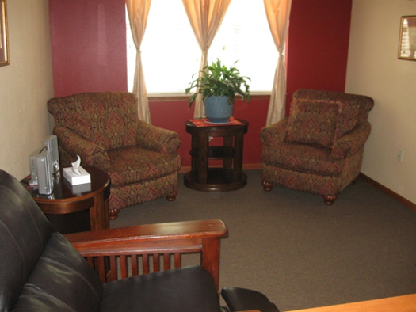
GH2
GH3
GH1
GH1 = Diana House; GH2 = WOW House; GH3 = Latimer House
GH1 = Diana House; GH2 = WOW House; GH3 = Latimer House

Slide 8
Study
GH1
GH2
Controls – same age and general functioning
N=15, from various places
GH3
• Residents compared on standard measures of health and function, co-incident conditions, and care needs
• Agency factors included costs, staffing and administrative decision-making
Dementia Group home residents
N=15, 5 per home

Slide 9
Timeline
T1 (2/11)
T2 (8/11)
T3 (2/12)
T4 (8/12)
T5 (8/14)
T6 (8/15)
T7 (8/16)

Slide 10
Study Instruments
T1-T4
The Longitudinal Health and Intellectual Disability Survey (LHIDS)
Caregiver Activity Survey-Intellectual Disabilities (CASID)
Assessment for Adults with Developmental Disabilities Scale (AADS)
Dementia Status Questionnaire (DSQ)
Group Home Site Questionnaire (GHSQ)
Kane Quality of Life Scale (KQoL)
Caregiving Difficulty Scale (CDS)
Administrative Factors (cost and staff data, interviews with administrative staff, environmental scans)
T5-T6
NTG-Early Detection and Screening of Dementia (NTD-EDSD)

Slide 11
Key extracts from longitudinal data
Time patterns of staff care provision by GH
Care activities key focus areas by GH
Dementia symptoms by GH
Most prevalent medical comorbidities
Administrative factors
Home specialization

Slide 12
Characteristics of Dementia GH Residents and Controls (T1 vs T5) [4.5yr]
 | GH#1 |  | GH#2* |  | GH#3 |  | Sum GH |  | Controls
 | T1 | T5 | T1 | T5 | T1 | T5 | T1 | T5 | T1 | T5
Age (mean) | 61.6 | 63.8 | 61.6 | 57.2 | 55.8 | 59.2 | 59.2 | 60.1 | 59.1 | 62.5
Age (range) | 51-68 | 53-79 | 49-76 | 52-69 | 44-70 | 47-73 | 44-76 | 47-79 | 44-75 | 46-77
Sexª F/M | 2/3 | 2/3 | 0/5 | 1/4 | 4/1 | 4/1 | 6/9 | 7/8 | 6/9 | 6/9
DS | 2 | 2 | 2 | 3 | 1 | 1 | 5 | 6 | 1 | 1
IQ | Mod 5 | Mod 5 | Mod 3 Sev 2 | Mild 1 Mod 2 Sev 2 | Mild 1 Mod 2 Sev 2 | Mild 1 Mod 2 Sev 2 | Mild 1 Mod 9 Sev 4 | Mild 2 Mod 9 Sev 4 | Mild 3 Mod 8 Sev 4 | Mild 3 Mod 7 Sev 3 Pro 1
BMI | 30.0 | 32.2 | 26.6 | 30.6 | 32.9 | 29.9 | 29.8 | 30.9 | 34.8 | n/a
Dem stage | Mod 5 | Mod 5 | Mod 3 Sev 2 | Mod 3 Sev 2 | Mod 3 Sev 2 | Mod 3 Sev 2 | Mod 11 Sev 4 | Mod 11 Sev 4 | - | -
Yrs since dementia Dx | 1-3: 3 3-5: 2 | 3-5: 4 5+: 1 | 1-3: 3 3-5: 2 | 3-5: 4 5+: 1 | 1-3: 5 | 1-3: 1 3-5: 4 | 1-3: 3.6 3-5: 2 | 1-3: 1 3-5: 12 5+: 2 | - | -
Co-morbidities | 8.0 | 10.0 | 7.4 | 12.2 | 8.2 | 14.0 | 7.9 | 12.1 | 4.8 | 6.7
Health Now | 2.6 | 2.2 | 2.2 | 2.6 | 2.2 | 2.2 | 2.2 | 2.3 | 3.2 | 3.1
Health yr ago | 2.8 | 2.6 | 2.6 | 2.8 | 2.6 | 2.6 | 2.7 | 2.6 | 2.9 | 3.0
ª Females /Males *Two original residents died since 2011 and were replaced with two others

Slide 13
Comparison of Time/Day in Each GH Spent on Care Activities (%)

Slide 14
Times collapsed: by GH staff care patterns

Slide 15
%/Minutes by Home Spent on Care Activities

Slide 16
CAS-ID: mean minutes spent on care tasks in dementia group homes vs. controls
Table 3

Slide 17
T5 – New observed symptoms by GH

Slide 18
Decline-associated behaviors - worsening

Slide 19
Behavior and Affect New Symptoms in Past Year

Slide 20
10 Most Prevalent Medical Conditions

Slide 21
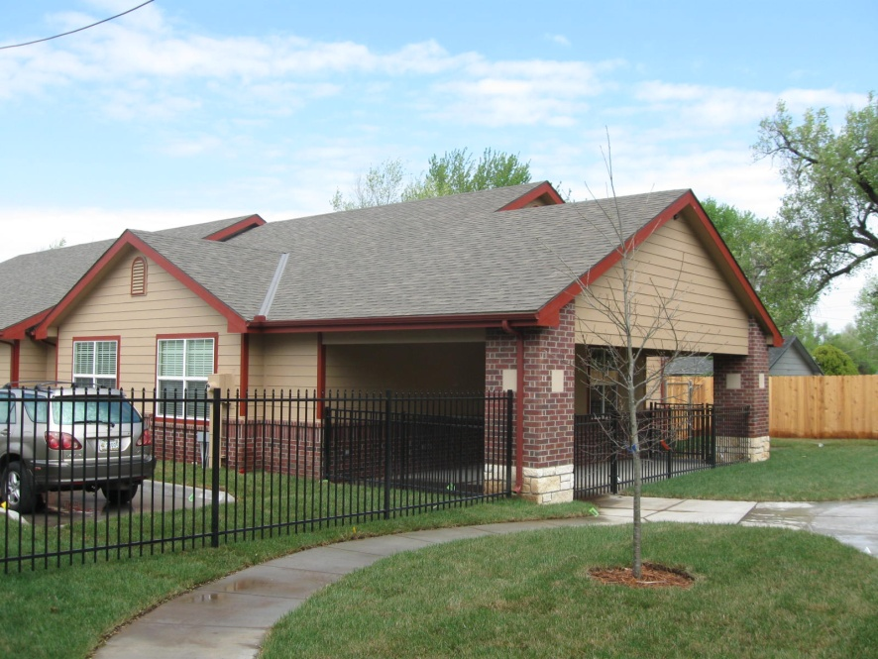
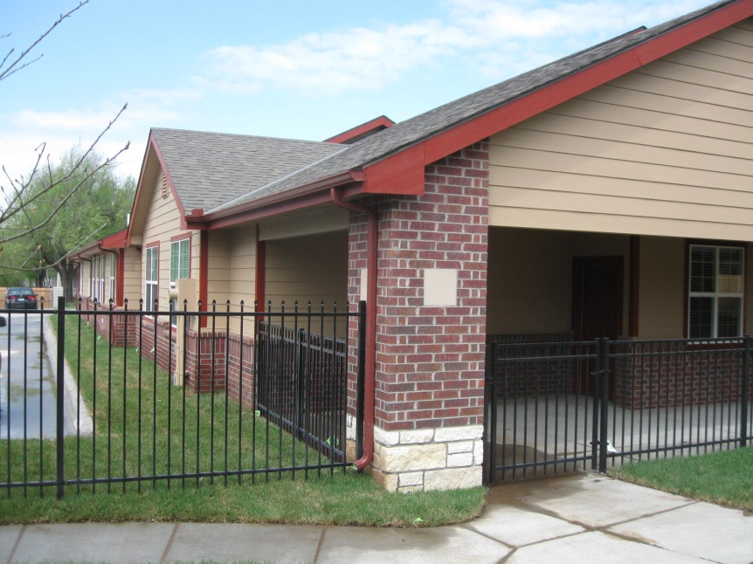
Administrative factors (T4)
Factor | GH1 | GH2 | GH3
Costs p.a. (Mean) | $41,395 | $48,196 | $50,491
Staffing (Full, Part) | 4, 2 | 4, 2 | 5, 3
Resident tenure | All still there | 2 deaths, replaced | All still there
Focus of day activity | Off site | Off site / on site | On site

Slide 22
Summary 1
Dementia affected adults in GHs are/have
More apt to have Down syndrome
Weigh less
Lower BMI
Greater number of co-morbidities
Demand/require 2x more staff time
Diminishing health over time

Slide 23
Advanced dementia
More comorbidities
Less activity
Longer duration of dementia

Slide 24
Two years later …
Evidence of change in function and increasing health problems or less ‘wellness’
Residents in homes 2 & 3 showed the greatest impact of dementia over the two years
Higher number of co-morbidities among dementia residents compared to controls
Staff time spent on caregiving much more than that for ‘the controls’
Trending toward individual home specialization as to level of care
Phase II: Longitudinal study [2014-2018] of agency experience
with the three community based dementia care group homes

Slide 25
Findings
GH3 was identified as the home serving adults who were most impaired (i.e., advanced dementia) on a number of factors:
In aggregate, more staff time was devoted to personal care (5.18h per day vs. =3.52h for the other two homes) and more staff were assigned to the home.
Per resident annual costs were the highest (US$50,491 vs =US$44,795 for the other two homes).
Residents showed the least new dysfunction-related symptoms (6.3% vs. =46.9% for the other two homes).
Residents showed lesser number of present symptoms showing decline (27.8% vs. =36.2% for the other two homes).
Prevalent co-morbidities included high blood cholesterol, thyroid disorder, depression, constipation, gastrointestinal pain, vision impairment, heartburn/acid reflux, incontinence, & dental pain (Number of overall comorbidities: 70.0 vs. =55.5 for the other two homes).
Advanced-dementia related changes seen as worsening included gait, personality, sociability, attentiveness, weight, and abnormal voluntary movements.
Residents were least able to participate in out-of-home programs and activities.
GH2 was identified as the home with residents experiencing most active change and newly observed dysfunction – and emerging as the home mid-way between GH#1 and GH#3.
GH1 was identified as the home with residents least impaired by symptoms associated with dementia.
Notes:
See Table 2014-4c for number of overall comorbidities.

Slide 26
Conclusions
Dementia care is affected by differences in complexity of impairments and co-incident conditions found in adults with dementia. When able, agencies will operate several dementia capable homes and will – over time – either administratively assign residents to home by degree of dementia-related impairment care needs or this will happen organically by virtue of how agencies replace adults who leave due to death or infirmity.
While the study is still underway, the telling aspects of variations among the home are becoming evident.
Expectations are that such specialization will become even more evident with time.
Recommendations include:
(a) planning should consider utility of matching incoming residents by stage of dementia impairment to maximize care outcomes;
(b) allocate greater number of staff to high demand care in mid-stage dementia; and
(c) track co-morbidities as dementia progresses.

Slide 27
Acknowledgements
This study is supported by Grant No 90RT5020-01-00 awarded by the Administration on Community Living’s (ACL) National Institute on Disability, Independent Living and Rehabilitation Research to the Rehabilitation Research and Training Center on Developmental Disabilities and Health at the University of Illinois at Chicago. The contents of this report do not necessarily represent the policy of ACL and should not be assumed as being endorsed by the U.S. Federal Government.
The cooperation of Starkey, Inc., the agency managing the group homes and which supplied the data at each interval, is greatly appreciated and acknowledged.
Thanks for Drs. Phil McCallion (Temple Univ.) and Larry Force (Mt St Mary’s College) for being part of Phase 1 of the study.
.

